Slide 1
New York City
Does Bad Weather make it worse?
Amit, Christy, MJ, Shruti
Notes:
Christy

Slide 2
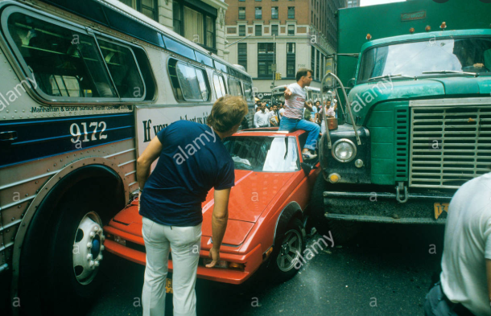

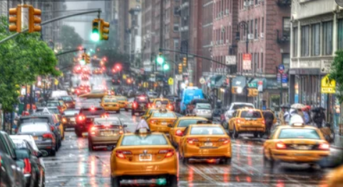
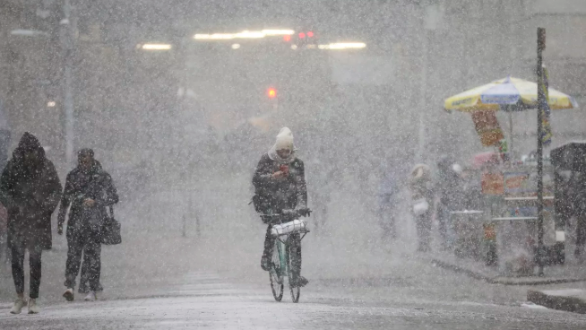
Living in the Big Apple – Does Bad Weather…
…cause more accidents?
…put more folks in cabs?
…cost more to heat your home?
Notes:
Christy

Slide 3
Data Gathering
(The Hardest Part of the Project)
Notes:
Christy

Slide 4
Where to Start?
Air Quality Index
BigQuery
SQL Skills
Got Scary
India Air Quality Index
Only one dataset
Less comparing
Not as rich of a data source
Canadian Political Results with Immigration Changes
Well…
Got too
Political
Endangered Languages comparison to Goodread Dataset
Turns out endangered languages
Don’t write books….
(Might be part of the problem?)
Notes:
Christy

Slide 5
Big City Living
Limited our scope to available datasets and the timeline left in the project
New York
Similar to Toronto
Found Collision Data
Found Weather Data
Found Cab Data
Found Energy Usage Data
This allows for multiple comparisons across datasets with multiple records (100,000 sets in each RAW file min)
Notes:
Christy

Slide 6
Main Data Sources
Kaggle Kaggle Kaggle & data.gov
**Historical Hourly Weather Data 2012-2017**
https://www.kaggle.com/selfishgene/historical-hourly-weather-data
**NYC Cab Trip Duration**
https://www.kaggle.com/c/nyc-taxi-trip-duration
**Hourly Energy Consumption**
https://www.kaggle.com/robikscube/hourly-energy-consumption
**Traffic Collision Data**
https://catalog.data.gov/dataset/traffic-collision-data-from-2010-to-present
Commonality: Date & Hour Data
Notes:
Christy

Slide 7
Data Exploration/Cleaning

Slide 8
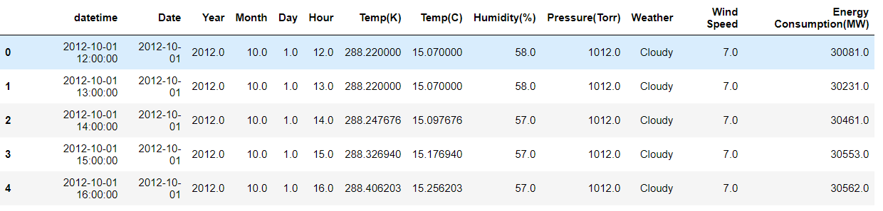
Data Exploration
Cab Data – New York
Collision Data
Started out with over 100,000 records from 2016 alone
Cleaned up all “NA” with dropna
10,000 remaining records
90% reduction in data on Step 1 of data cleaning
For 2016 alone – 300,000 incidents
Energy Data
Notes:
Collision – MJ
Cab Data - Shruti

Slide 9
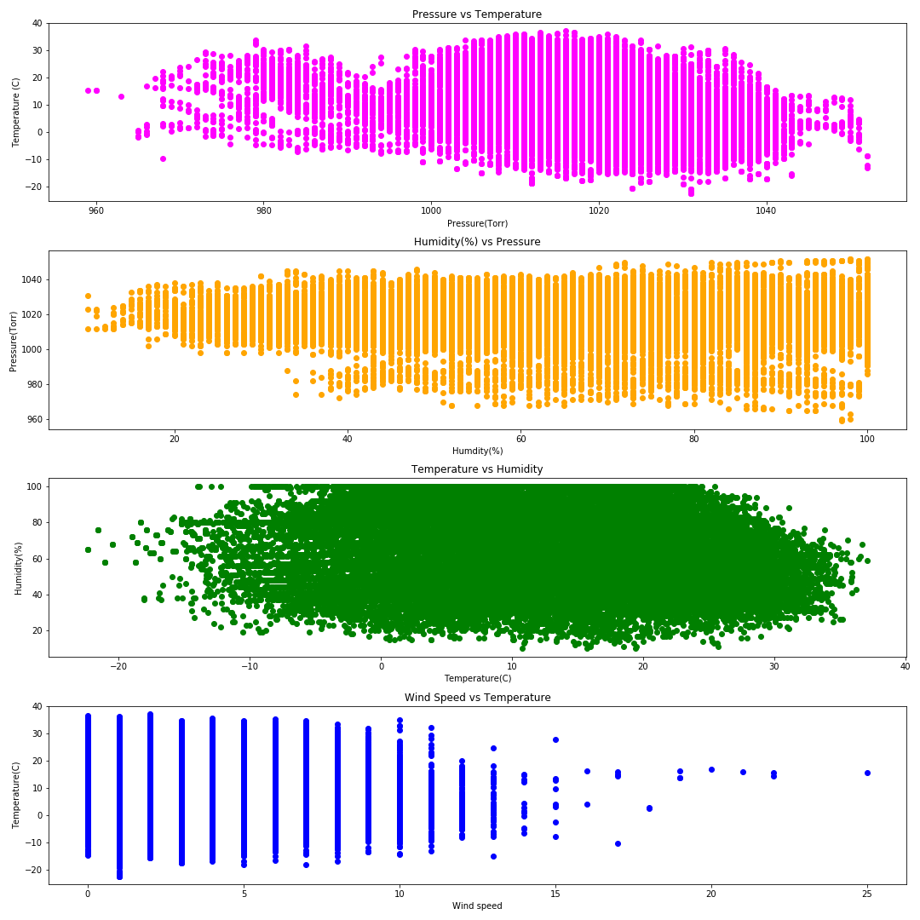
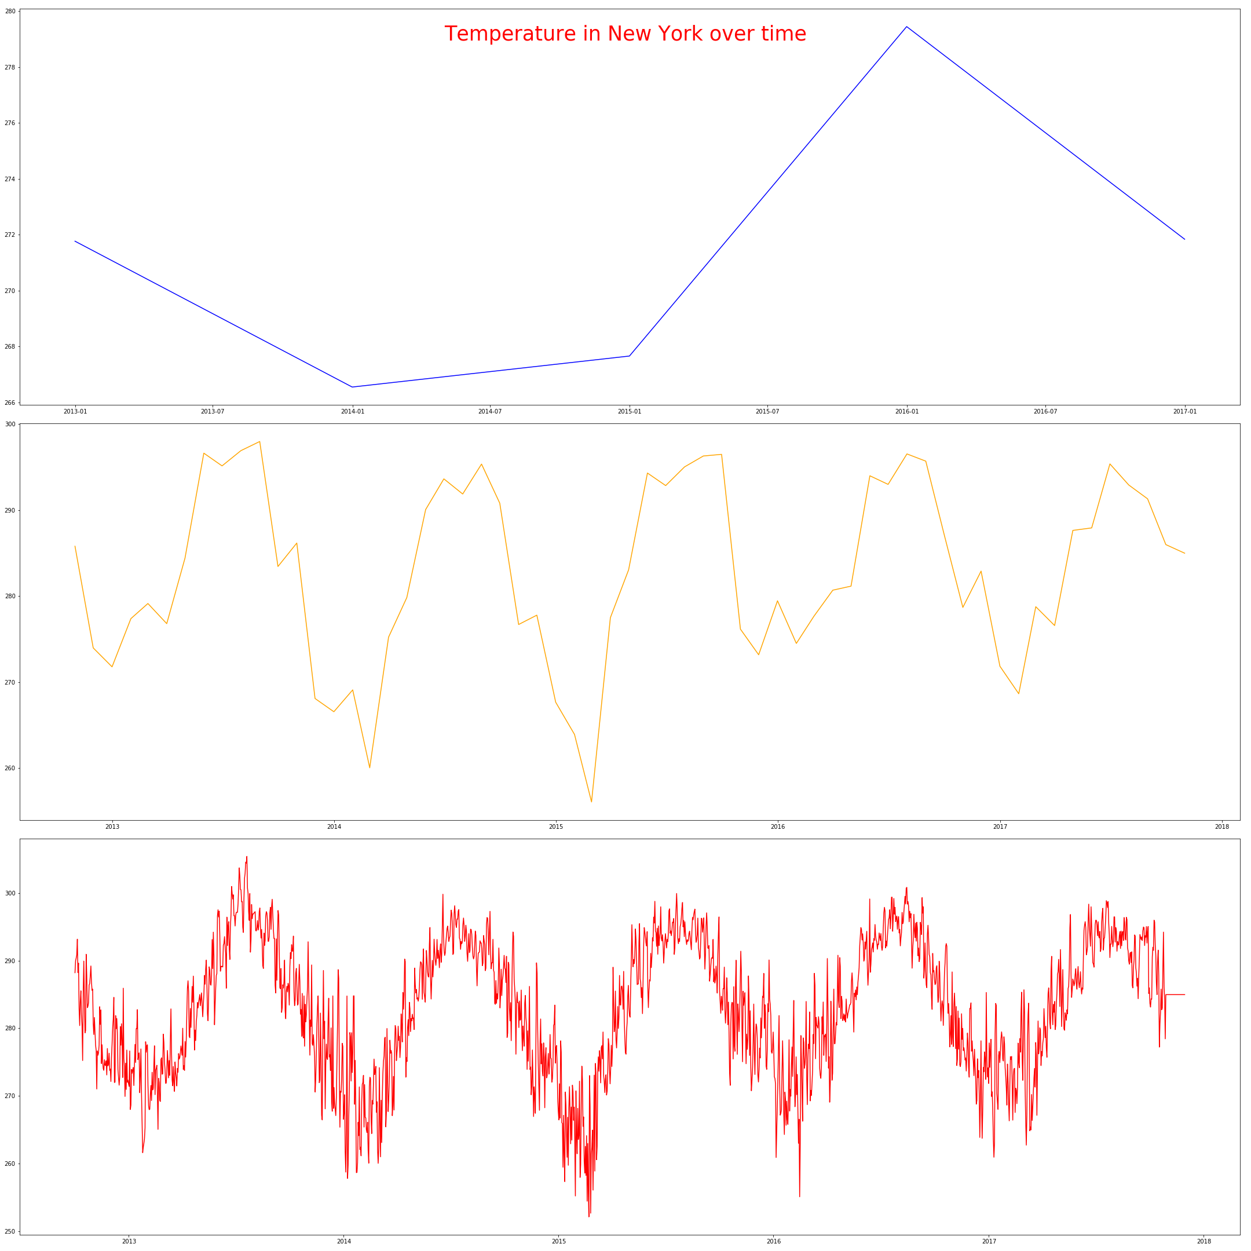
Data Exploration
Weather Data
No weather data beyond November 2017
Notes:
Amit

Slide 10
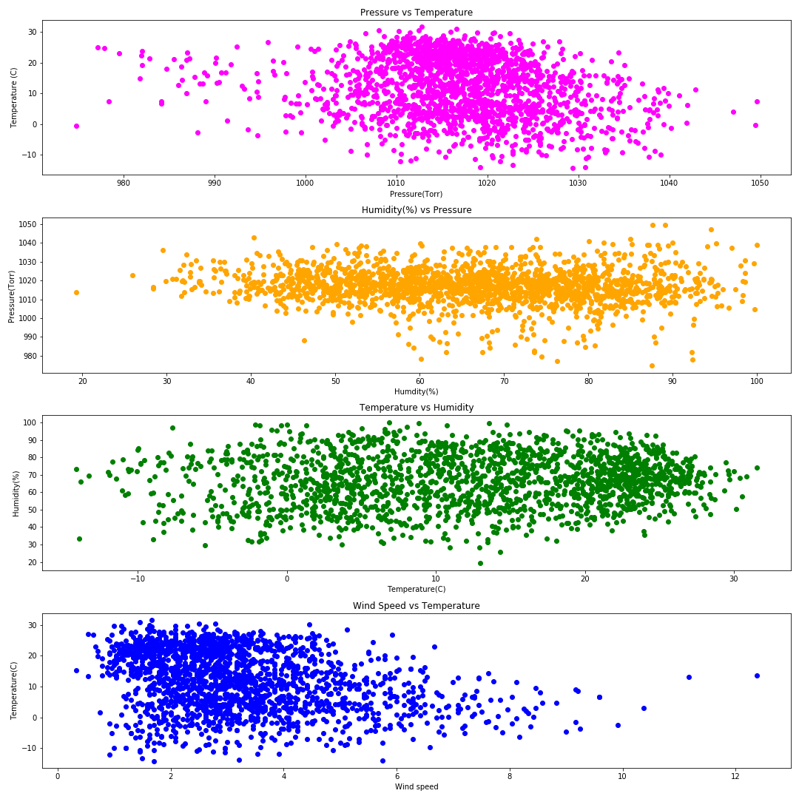
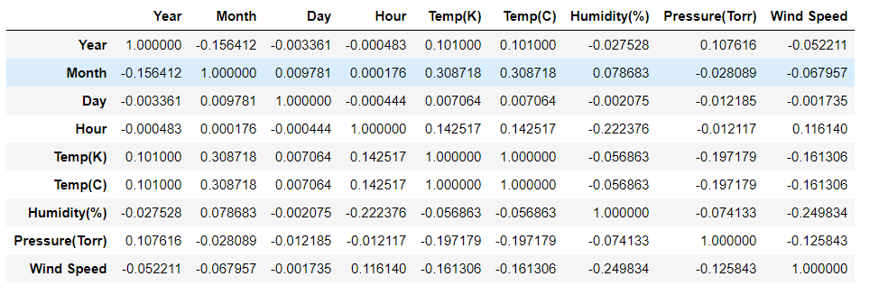
Data Exploration
Weather Data
Notes:
Amit

Slide 11
Data Merging Challenges
Date & Hour Data
All Data Sets Required Same Data Formatting for Merging
Objects versus DateTime
But Date & Time not necessary for Analysis:
Date/Time | Temperature (ºC)
Date/Time | Weather Condition | #Accident
Temperature (ºC) | Weather Condition | #Accident
Notes:
Christy

Slide 12
Data Analysis

Slide 13
Weather & Collisions
Does Weather Conditions have an impact on # of collisions that occur?
Notes:
MJ

Slide 14
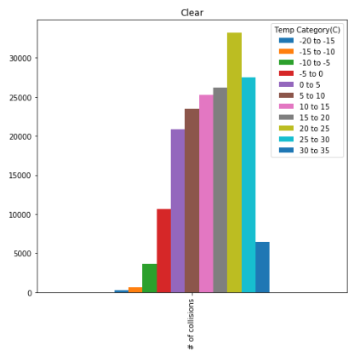
Graph of Clear Day and # Of Collisions
Observations - Higher # of Collisions when the temperature is 20-25C
Notes:
MJ

Slide 15
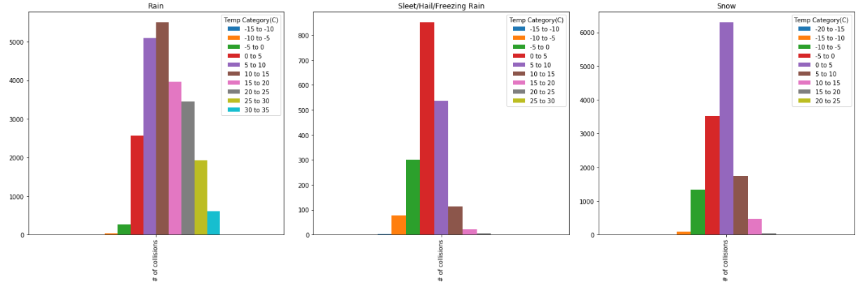
Graphs of Rainy Day, Sleet and Snow Days
Observations – Rainy Days - Higher # of Collisions when the temperature is 5-15C, Where Sleet/Hail/Freezing Rain and Snow have higher # of collisions when the temperature is 0-5C.
When there is precipitation of any sort (Rain/Snow) accidents are likely to occur between 0-15C.
Notes:
MJ

Slide 16
Weather & Cab Rides
Does Weather Conditions have an impact on # of cab rides that occur?
Notes:
Shruti

Slide 17
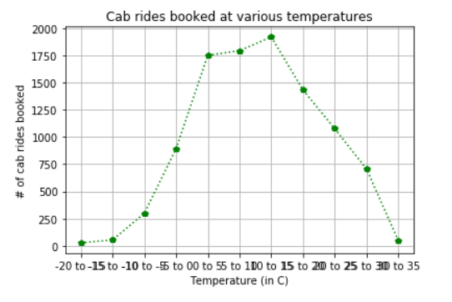
Temperature vs Cab Rides
Observations: Low temperatures didn’t result in high cab rides as initially anticipated, we therefore assume that this must mean that they worked remotely/had a snow day.
Notes:
Shruti

Slide 18
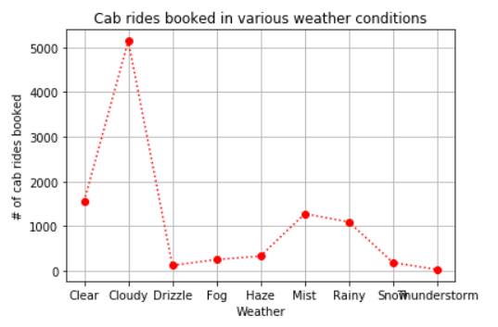
Weather Conditions vs Cab Rides
Observations: Cloudy days correlates with high cab rides
Notes:
Shruti

Slide 19
Weather & Energy Usage
Does Weather Conditions have an impact on how much energy a New Yorker uses?
Notes:
Amit

Slide 20
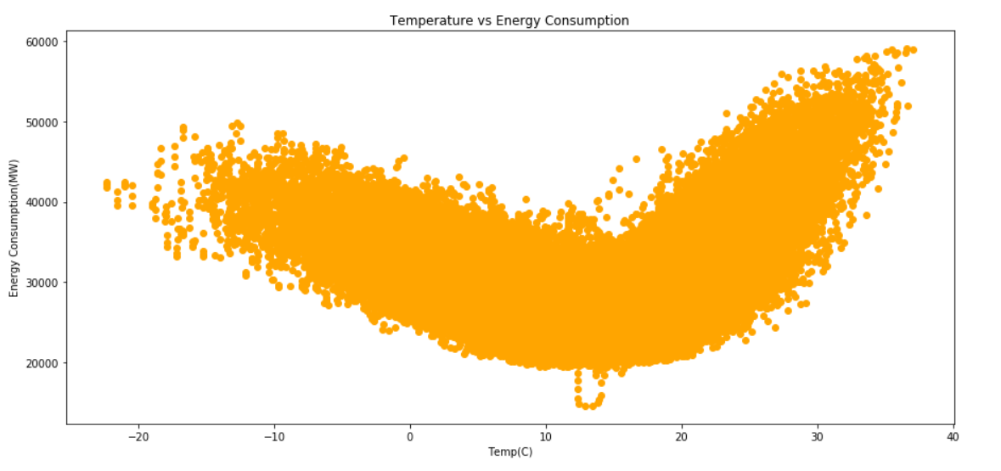
Temperature vs Energy Consumption
Observations: A/C requires more energy than Heating does, had expected heating to require more energy than A/C
This is electrical energy only, further analysis into what do New Yorkers have installed in their apartments.
Notes:
Amit

Slide 21
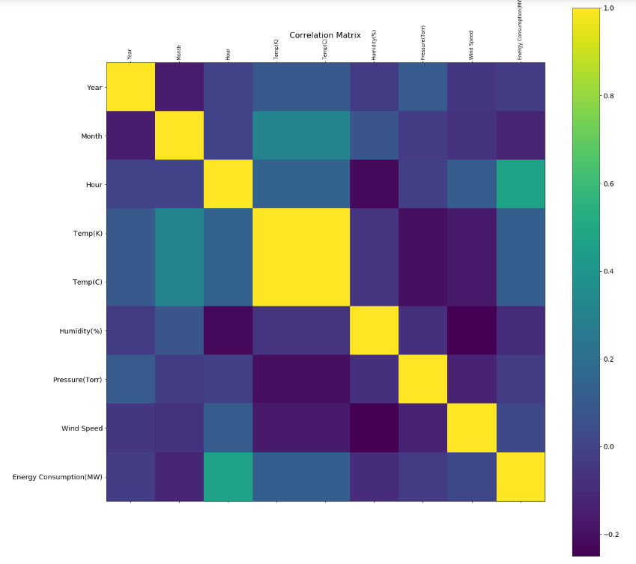
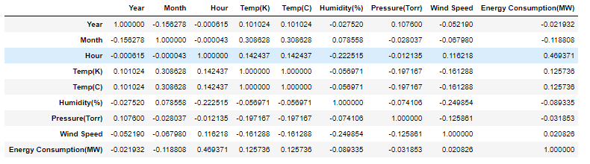
Correlation Chart
Relation between energy consumption and other factors e.g. Humidity, Temperature
Brighter the colour – higher the correlation
Darker the colour – lower the correlation
Notes:
Amit

Slide 22
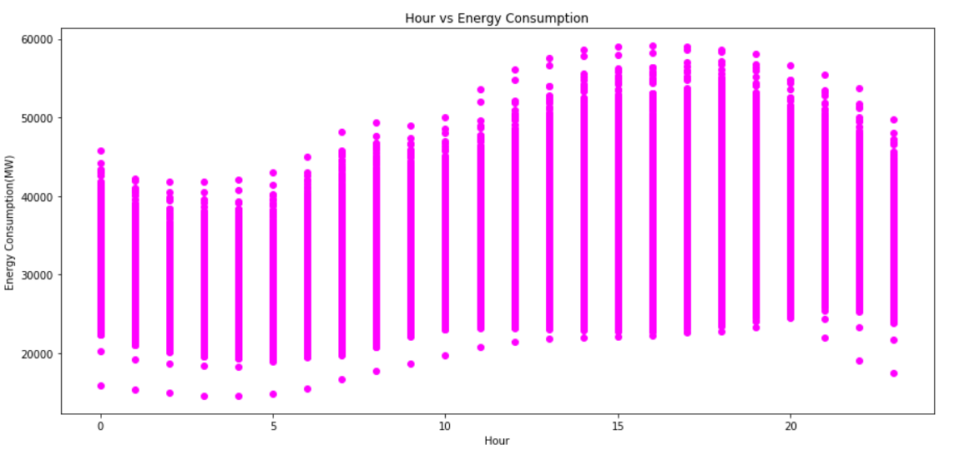
Time of The Day vs Energy Usage
Observations: Highest Consumption rates are between 2pm to 8pm in the evening & the lowest between 2-5am. Time of the Day matters.
Notes:
Amit

Slide 23
Discussion
Notes:
Christy

Slide 24
Main Conclusions
If the sky is clear and it’s 20-25C
Don’t go outside you’ll get hurt
If the sky is rainy/snowy and it’s 0-15C
Don’t go outside you’ll get hurt
When it is snowy and below 0C
New Yorkers don’t go outside
If it’s cloudy
Be prepared to pay surge price for an Uber
When it’s warm and above 20C
Don’t be surprised if the energy costs more because folks use more
When it is between 2-8pm
Don’t be surprised if the energy costs more because folks use more
Clear <20C is OK
Notes:
Christy

Slide 25
Post Mortem
Notes:
Christy

Slide 26
If we had more time
Weather Normalization
Normalize all the data sets to aid in more accurate comparisons
# of clear days, # of rainy days
Energy Usage Types
Take into consideration other sources other than electrical
What type of energy sources are used in New York households to see if that is part of the difference between heating/Air Conditioning-
Notes:
Christy

Slide 27
Q&A

